Slide 1
DATA CHALLENGE
Author: Yunuo(Megan) Wu
Notes:
Have you ever thought about for Rental market – Manhattan or other Boroughs

Slide 2
1. Introduction
A real estate company: purchasing properties to rent out short-term specifically within New York City
Problem: which zip codes are the best to invest
Solution: 1. high annual return on the investment.
2. small initial investment.
1.1 Problem Statement
Notes:
In this pre, we will show you a specific case

Slide 3
1. Introduction
The investor will pay for the property in cash
The time value of money discount rate is 0%
The investors won’t consider selling properties
The Airbnb hosts gain same revenue as the table shows every year
70% of people rent once for a day, 20% of people rent once for a week, 10% of people rent once for a month
Profit maximum in all situations (e.g. customer will bring the maximum number of guests they can to the property )
1.2 Assumptions
Notes:
Accommodates: Indicates the amount of people the host is allowing to occupy the property.
guests_included: Indicates the number of guests the host is allowing you to bring along.
extra_people: Additional charge per additional guests you bring

Slide 4
1. Introduction
Field | Description
reprice | Price the host is really charging to stay per night considering the discount for weekly reservation and monthly reservation
value | Current Value of Investment, refers to the proceeds obtained from the sale of the investment
cost | The house price in Jan 2020
ROI | A performance measure used to evaluate the efficiency of an investment
PP | The amount of time it takes to recover the cost of an investment
logcost | Apply log to cost
1.3 Created Metadata
1.4 Other Sources
geoJSON file that has NYC zip code boundary coordinates: https://raw.githubusercontent.com/fedhere/PUI2015_EC/master/mam1612_EC/nyc-zip-code-tabulation-areas-polygons.geojson

Slide 5
(1) Airbnb
Field | Quality Dimension | Data Cleaning
zipcode | completeness | Fill null values based on the longitude and latitude given in the dataset
bedrooms | accuracy | Filter two bedrooms properties since they are most profitable
state | validity accuracy | Fill null data Modify one state with only one name
weekly_price | completeness | Fill null values
monthly_price | completeness | Fill null values
Extra_people | validity | Drop dollar sign and make it float
2. Quality Check
Six data quality dimensions:
Completeness
Uniqueness
Timeliness
Validity
Accuracy
Consistency
(2) Zillow
Field | Quality Dimension | Data Cleaning
time | consistency | Filter the month in which there are missing values
city | accuracy | Filter the NYC
(3) Merged Dataset — df_join[cols]
Airbnb miss the information for zip code 10312
Merge Airbnb and Zillow based on the common variable “zipcode”
24 zip codes and 1573 rows
Notes:
Upper case and lower case letters

Slide 6
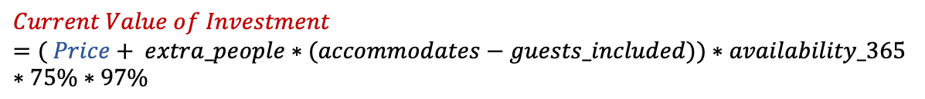
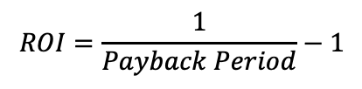

Two measures of annual return
$$ROI=\frac{Current Value of Investment − Cost of Investment}{Cost of Investment}$$
3. Data Munging
$$Payback Period=\frac{Cost of Investment}{Current Value of Investment }$$
(Break even)
$$ROI=\frac{1}{Payback Period}−1$$
(in this simplified situation)
3.1 Related Formula
(2) A measure of initial investment
$$Cost of Investment = Current House Price$$
(predicted)
(3) Calculation Process
$$Current Value of Investment=( Price+ extra_people∗(accommodates−guests_included))∗availability_365∗75\%∗97\%$$
$$Price=0.7∗daily_price + \frac{0.2∗weekly_price}{7}+\frac{0.1∗monthly_price}{30}$$

Slide 7
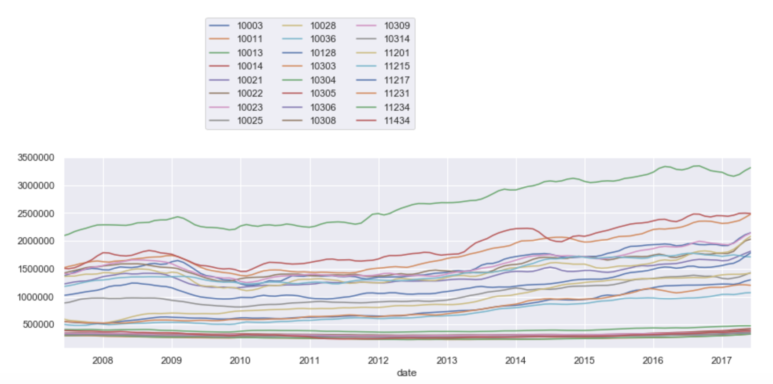
Plot the data
3. Data Munging
3.2 Time series Predicting
(house price)
Insights:
There is an upward trend.
There are no obvious outliers
There seems no seasonality
The variance seems constant

Slide 8
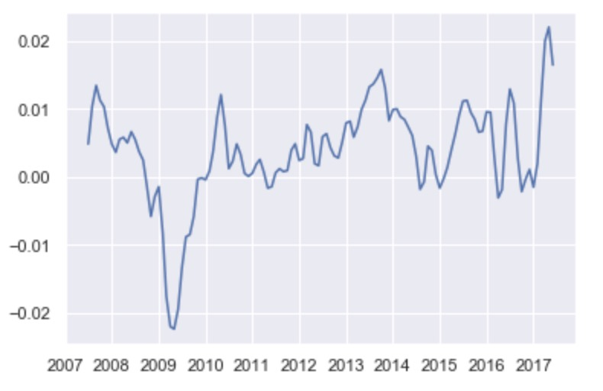
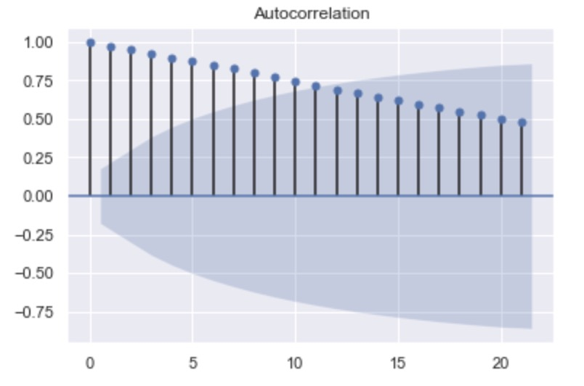
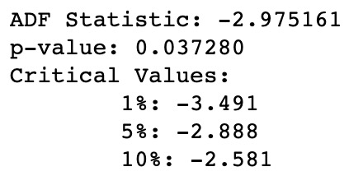
(2) Stationarity
3. Data Munging
3.2 Time series Predicting
(house price)
* Plot of lag-1 difference data
* ACF plot of original data – Not Stationary
* ADF test results of lag-1 difference data
Insights:
After taken one difference, the data become stationary.
Notes:
Trend, non constant variance, sticky
Null hypothesis : unit root is present / not stationary
can reject the null hypothesis that the data is not stationary at the 95% confidence level

Slide 9
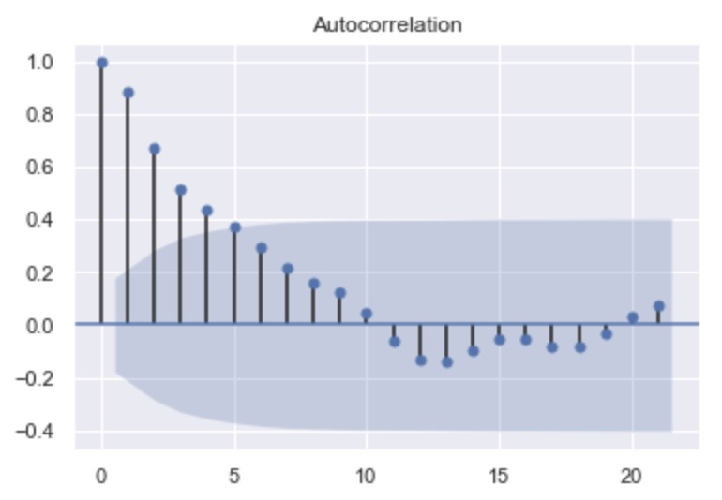
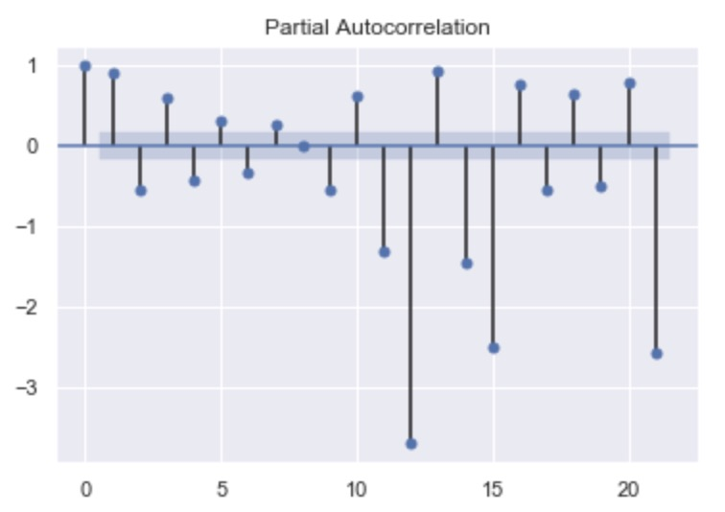
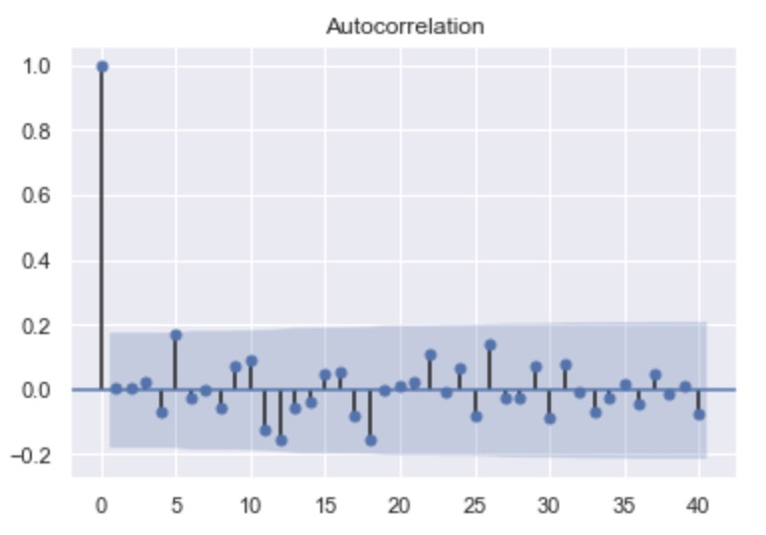
(3) ARIMA Model Parameter Choosing
3. Data Munging
3.2 Time series Predicting
(house price)
Insights:
ACF Plot: the autocorrelation decays fast. It may show a AR(4) process
PACF Plot: it is difficult to get more information here
I write a for loop to test all possible number combinations and find the combination that carries the smallest BIC.
After testing, p=1 and q=3 is the best.
* ACF plot of ARIMA(1,1,3) – white noise
Notes:
In real life, the values of parameter p and q are usually no more than 4.

Slide 10
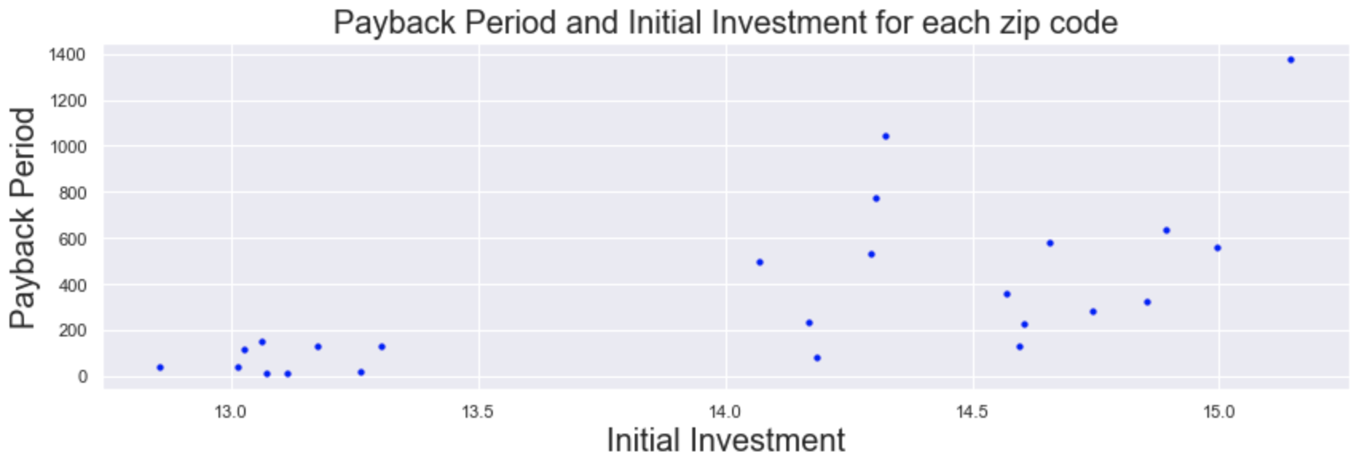
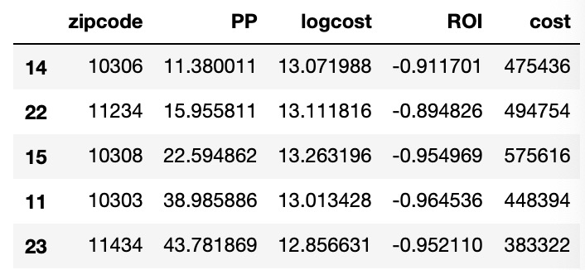
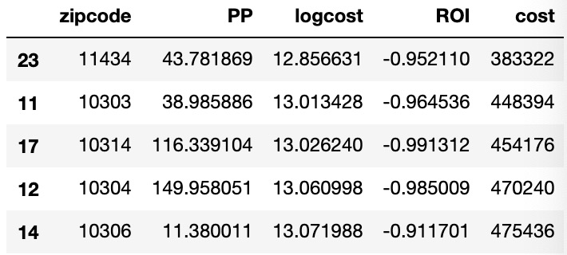
4. Data Application
Personized Recommendation
For investors who want to reach to the breakeven point as soon as possible:
10306(Staten Island)
located in Richmond County
has the lowest payback period
For investors who have limited budget:
11434(Queens)
located in Jamaica City
has the lowest initial investment
For investors without special preference:
10303(Staten Island)
located in Richmond County
a good balance between initial investment and payback period
* top five zip codes which have the smallest payback period
Property Portfolio?
* top five zip codes which have the smallest initial investment
Notes:
Asset diversification

Slide 11
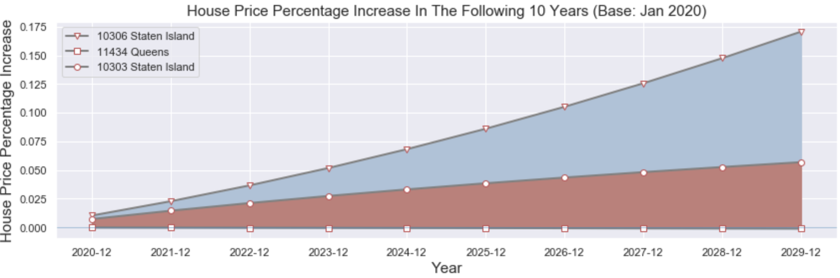
5. Data Visualization
5.1 Stackplot
Reason:
understand the market
– property value change
Sell properties in the future?
Staten Island
higher asset appreciation in 10306
lower asset appreciation in 11303
2) Queens
asset depreciation in 11434
Notes:
Although we assume, still important to understand the risk we are facing
So when I prepared for presenting, I decided to add this visualization to dip deeper about..
Show the property value changes in a specific year

Slide 12
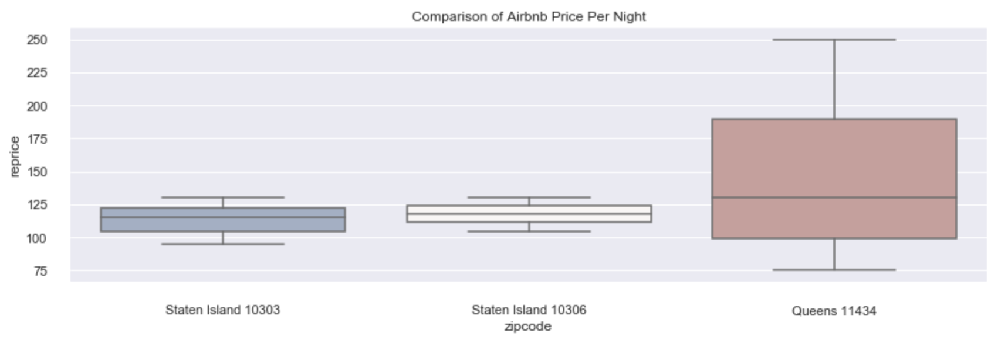
5. Data Visualization
5.2 Boxplot
Reason:
explore profit risk
– Airbnb price fluctuation
Same profit in a zip code?
Staten Island
stable Airbnb price per night
homogeneous profitability across different houses
2) Queens
Large variance in Airbnb price per night
Heterogeneous profitability across different houses
Suggestion:
Search information for specific houses when purchasing rental house in zip code 11434

Slide 13
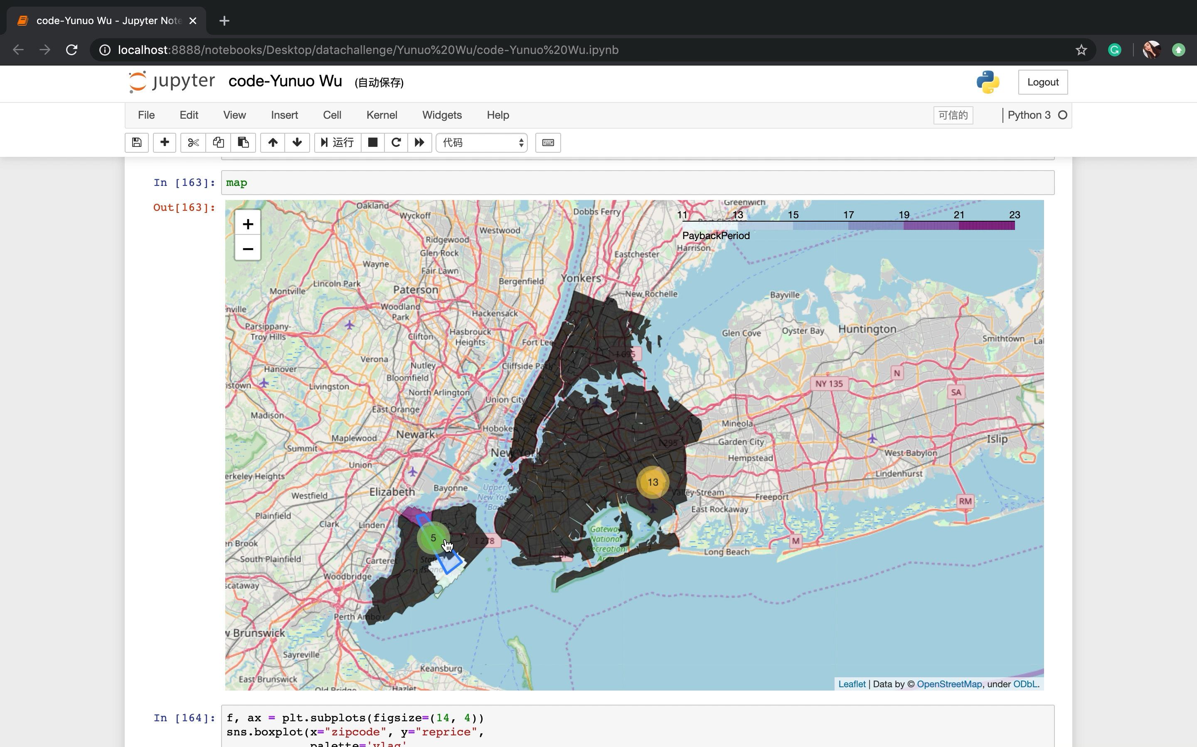
5. Data Visualization
5.2 Interactive Map
Reason:
explore profit driven factor
– location
Notes:
target consumer – vacation rental property

Slide 14
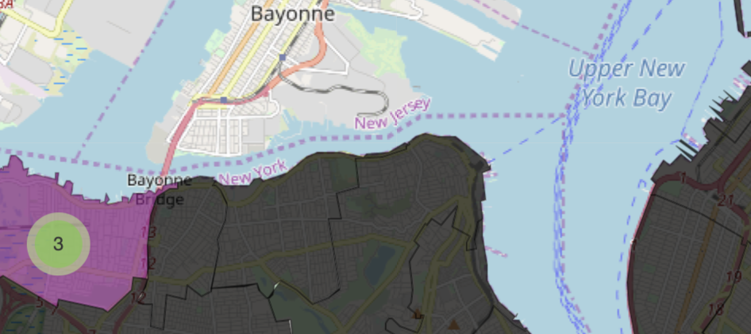
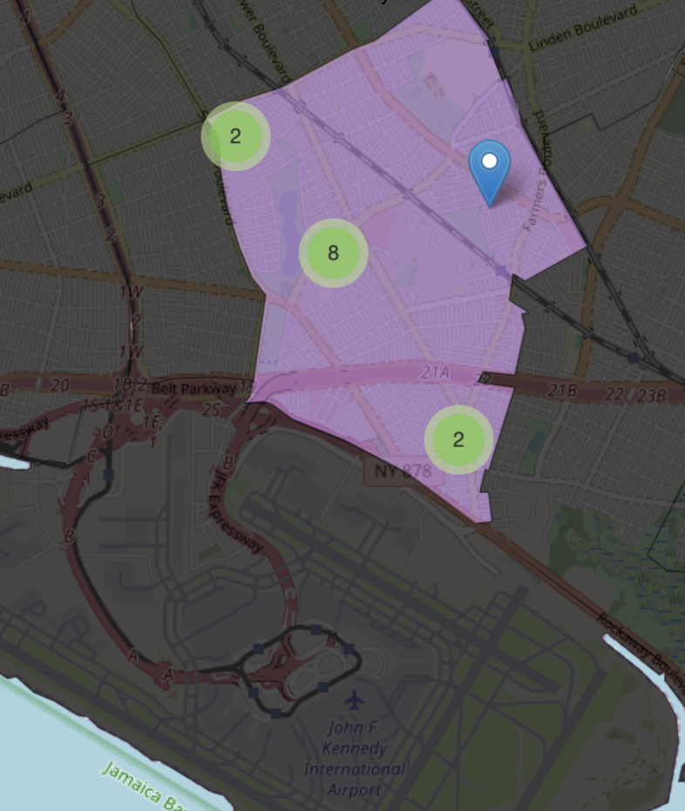
5. Data Visualization
Why profitable?
Close to the coastline
seascape building
convenient transportation
Close to the airport
zip code 11434 is near to JFK airport
good choice for tourists who just arrive or are scheduled to depart
Close to the ferry
zip code 10306 and 10303 are near to St. George Ferry terminal
easy transportation to Manhattan
the Statue of Liberty
5.2 Interactive Map
Notes:
Give answer to my question at the very beginning
Intuition: most profitable Airbnb’s are located in Manhattan that has the most attractions. Our analysis reveals this approach to be totally wrong.
Acceptable investment – features(waterfront property / NYC landmark )

Slide 15
The ARIMA model
built on average house price of all zip codes in NYC
inaccurate prediction: not suitable for each zip code
Solution:
write a for loop to find the best parameters for each zip code
2) Occupancy rate
set 75% as the occupancy rate for all properties
inaccurate prediction: higher in popular destinations
Solution:
Improve the model with information in Mashvisor (a well-known real estate platform offering an occupancy rate table based on the review_scores_location)
6. What’s Next

Slide 16
Thank You For Listening!

